Slide 1
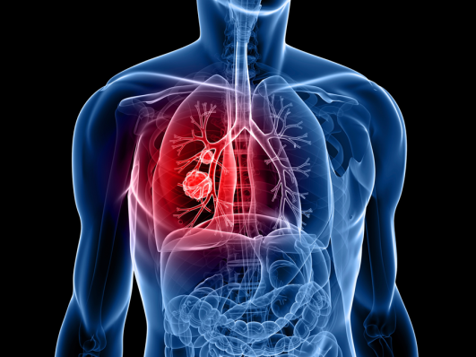
Lung Cancer
Dr Huda badri

Slide 2
Overview of session
Learning objectives
Quiz
Tutorial on lung cancer and guidelines
15 minutes break
Case studies
10minutes break
End of life care and ethical considerations

Slide 3
quiz
More women die of breast cancer than lung cancer, true or false?
Small cell lung cancer is more common than non-small cell lung cancer, true or false?
Squamous cell carcinoma is the most common non-small cell lung cancer sub-type, true or false?
The treatment of choice for Superior Vena Cava Obstruction is stenting, true or false?
Urgent referral for a chest X ray should be made if a patient has shoulder pain > 3weeks, true or false?
The risk of pneumothorax is 50% post CT guided biopsy, true or false?

Slide 4
quiz
Lung cancer cure rate is 20%, true or false?
Radiotherapy can be given as a curative treatment in non small cell lung cancer, true or false?
Small cell lung cancer can be a cause of SIADH, true or false?
Alveolar cell carcinoma is a type of small cell lung cancer, true or false?

Slide 5
Indications for URGENT CXR- NICE guidance 2011
Heamoptysis and or
>3 week history of;
Cough
Chest/shoulder pain
Dyspnoea
Weight loss
Chest signs
Hoarseness
Finger clubbing
Features suggestive of metastasis from a lung cancer (bone, liver, skin)

Slide 6
Lung cancer epidemiology
In excess of 39,000 cases each year in the UK
35,000 deaths per year > than breast and colorectal combined
Lung cancer is now leading cause of cancer death in UK
90% of lung cancer caused by smoking
Only 5.5% are cured

Slide 7
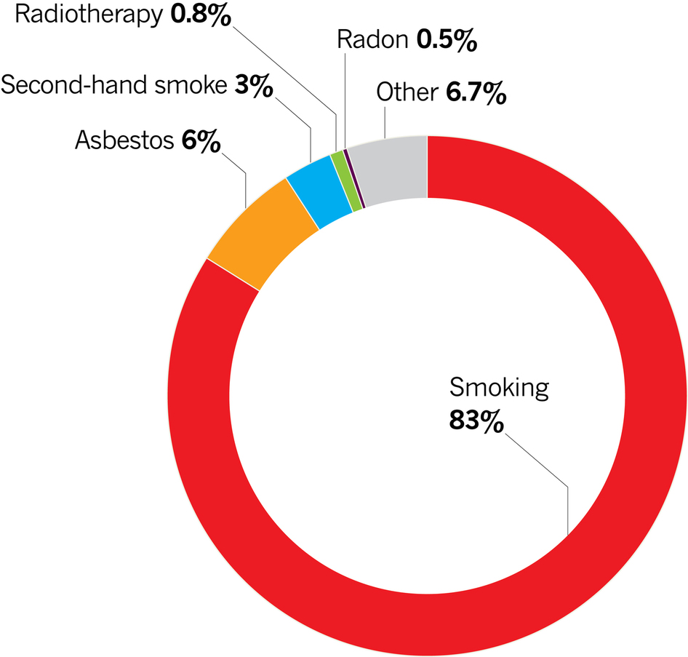

Slide 8
Types of lung cancer
Non small cell lung cancer (NSCLC)
Squamous cell carcinoma
Adenocarcinoma
Large cell carcinoma
Alveolar cell carcinoma
Carcinoid
Small cell lung cancer (SCLC)

Slide 9
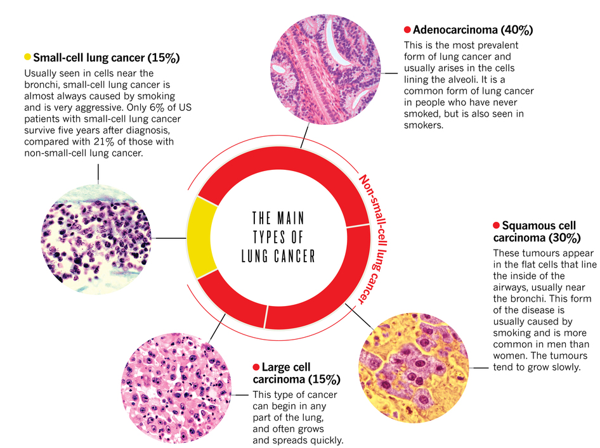

Slide 10
Symptoms and signs
Local tumour effects
Cough
Heamoptysis
Chest pain
Unresolved pneumonia
Unexplained shortness of breath
Metastatic tumour effects
Cervical/supraclavicular lymphadenopathy
Palpable liver edge
Bone pain/pathological fractures
Neurological signs

Slide 11
Diagnosis and assessment
CXR
Routine bloods (FBC, U&Es, Ca, Clotting, LDH)
CT (staging THORAX, ABDO,PELVIS) +/- PET CT
Full Pulmonary Function tests +/- ECHO
Bronchoscopy/EBUS/
CT/ USS guided biopsy
Thoracoscopy
Open lung biopsy +/- resection
Lung cancer MDT involvement at all stages

Slide 12
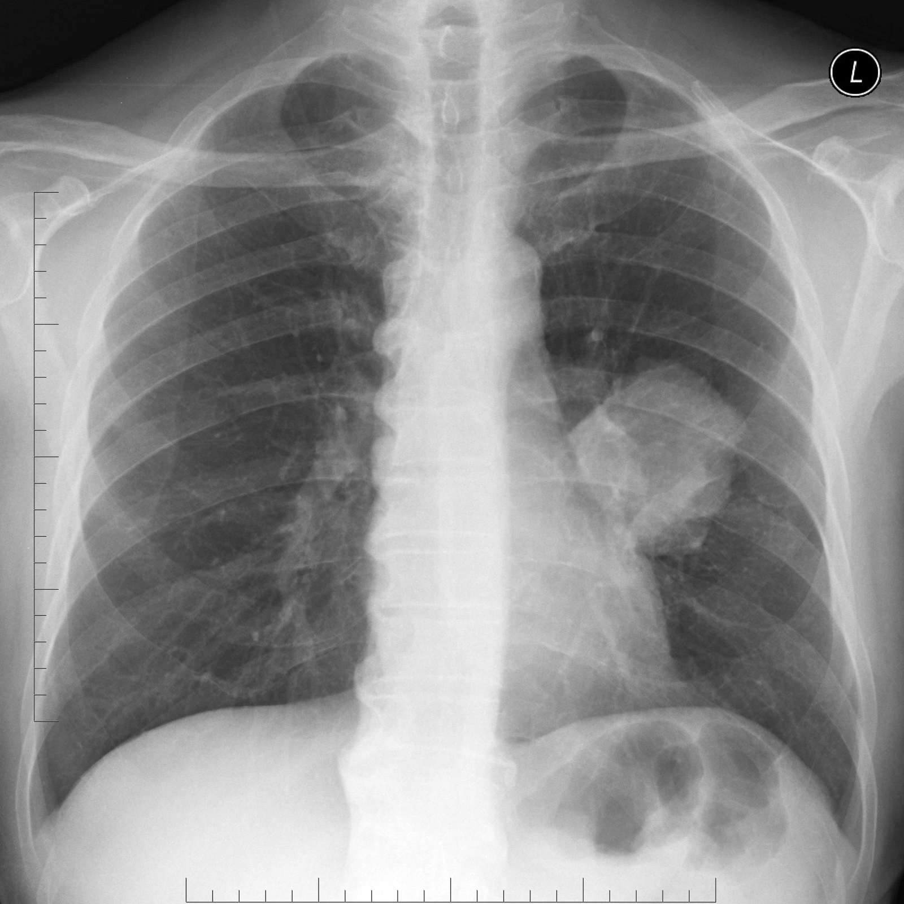

Slide 13
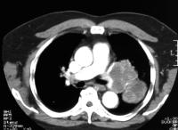

Slide 14
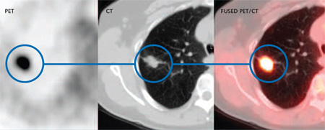
Positron Emission Tomography- Computed Tomogoraphy (PET-CT)

Slide 15
Thoracoscopy

Slide 16
EBUS

Slide 17
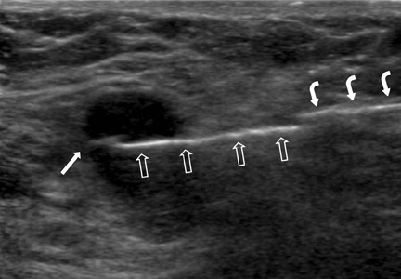
USS guided biopsy

Slide 18
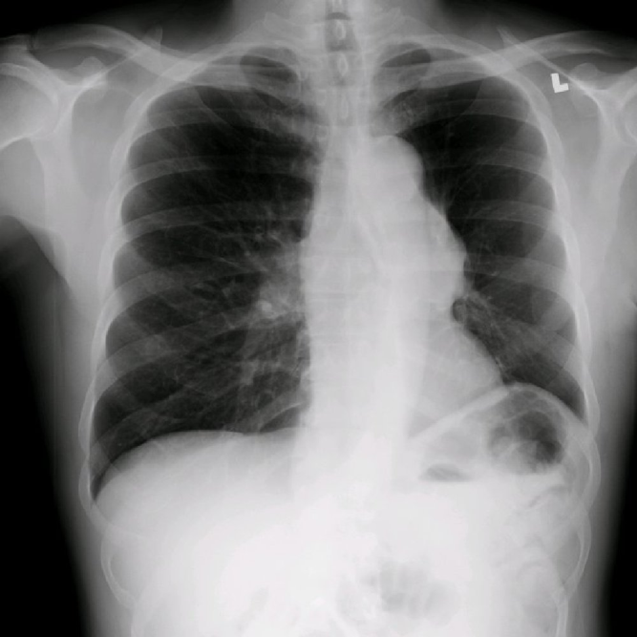

Slide 19
staging

Slide 20
Management
Lung MDT
Lung cancer specialist nurses
Specific treatment based on diagnosis and fitness of patient

Slide 21
Treatment NSCLC
Stage dependent:
Radical treatment offered for early stages either:
Radical Surgery (T1a-3, N0-1,M0) or
Radical Radiotherapy
Later stages:
Chemotherapy alone
Symptomatic treatment

Slide 22
Treatment SCLC
Mainly chemotherapy plus radiotherapy
Surgery only in very limited disease as part of combined radio/chemotherapy

Slide 23
Complications 1 : SVCO
94% of Superior Vena Caval Obstruction is due to malignancy
10% of small cell lung cancers present with SVCO
Clinical features
Facial and upper body oedema, facial plethora, increased neck circumference and cyanotic appearance.
“Pemberton’s sign”
Breathlessness
Headache
Cough/heamoptysis
Hoarse voice
Dysphagia
Syncope/dizziness
Confusion

Slide 24
cases

Slide 25
Case 1
55 year old lady
Lifelong smoker
12 months worsening shortness of breath
6 months back pain
6 weeks history of leg weakness
PMH- COPD
Mild end expiratory wheeze bilaterally
Bilateral lower limb weakness
Attended clinic in a wheelchair

Slide 26
investigations

Slide 28
Investigations and management
CT guided biopsy- adenocarcinoma
Palliative radiotherapy
Symptomatic treatment
Progress
Deteriorated 8 weeks after presentation and died.

Slide 29
Case 2
75 year old male
Never smoked
Retired plumber
Weight loss 2 stones over 6 months
Shortness of breath
Physical examination
Reduced breath sounds Left base, dull percussion note

Slide 30
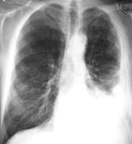

Slide 31
Investigations and management
CT thorax/abdo/pelvis
Thoracoscopy- biopsy squamous cell lung cancer
Pleural effusion drained and talc pleural adhesis performed.
Chemotherapy offered
Progress
Shortness of breath improved and he as able to visit family down south
4 months later further deterioration in health and died

Slide 32
Case 3
65 year old male
Ex-smoker with 25 pack year history
Very fit, goes to the gym daily
Works as a managing director of a small firm
Minor road traffic accident, had chest x-ray as had chest pain, incidental finding

Slide 33
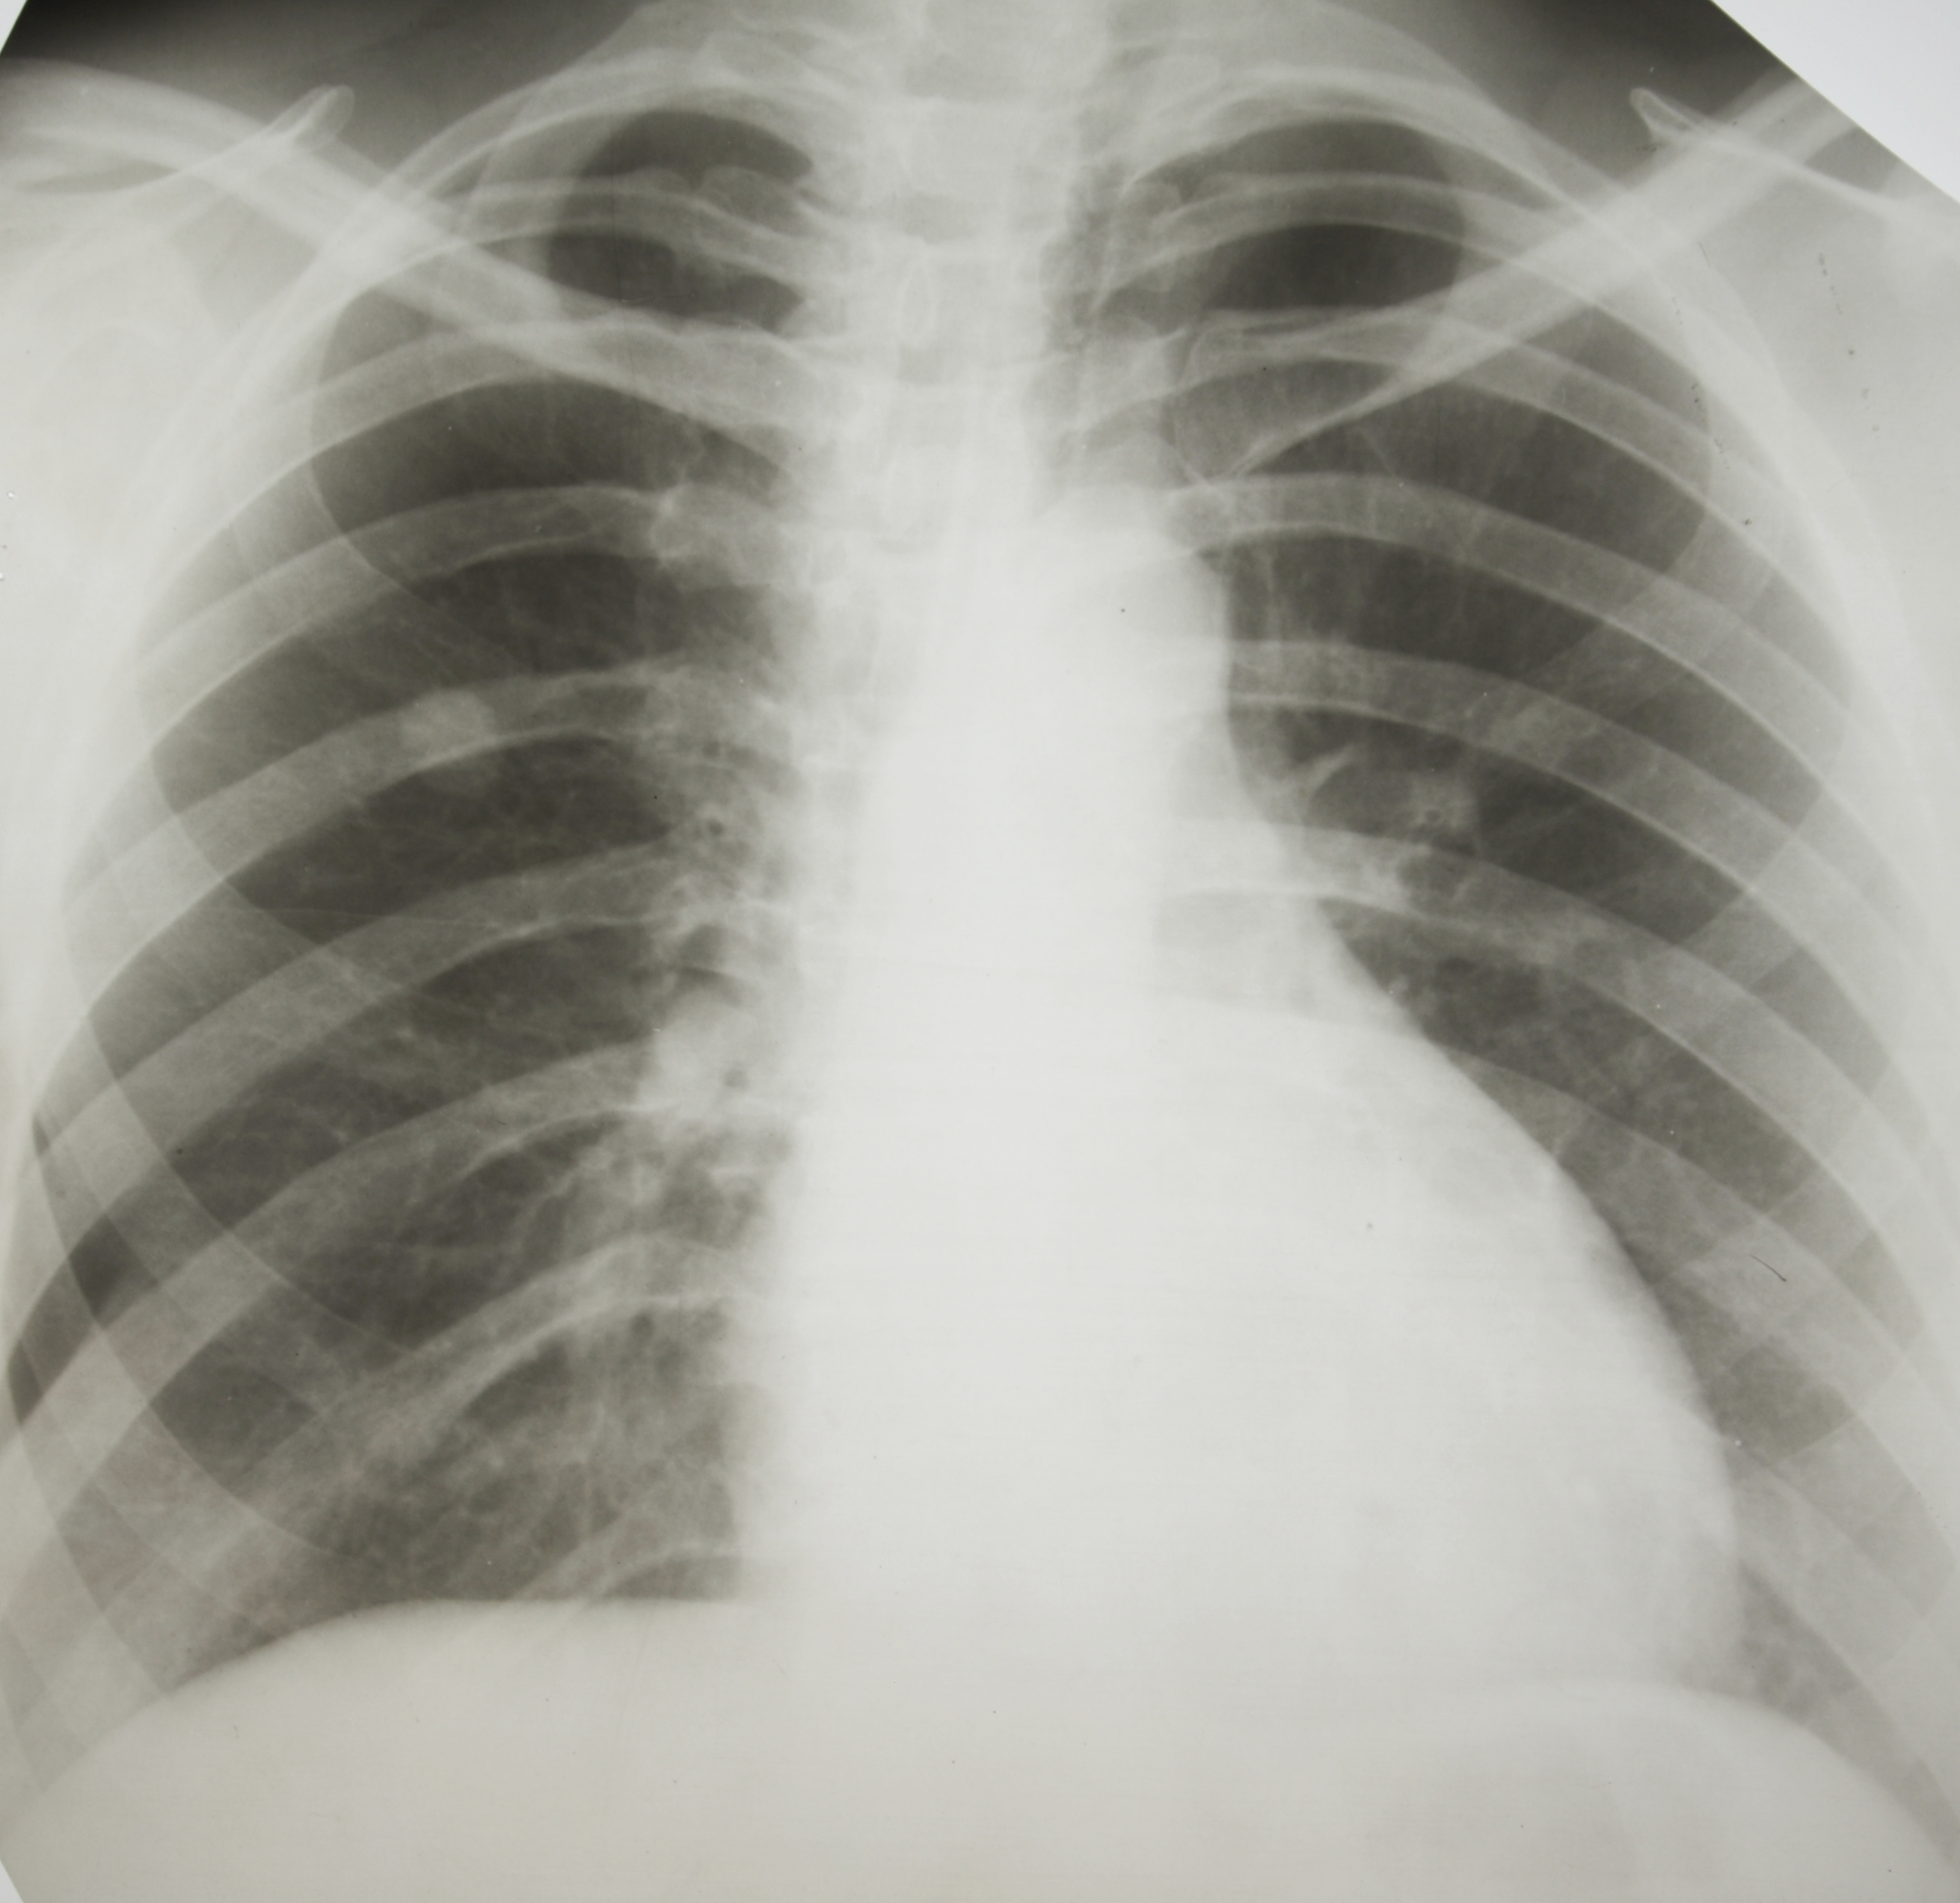

Slide 34
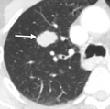

Slide 35
Further work up and management
PFTs
PET CT scan
Surgical assessment
Accepted fro surgery
Pneumonectomy performed as tumor crossed the fissure
Margins were clear thus, no chemotherapy needed
3years post op doing well

Slide 36
End of life care
Discussions should be made early on after diagnosis, should not be left to terminal stage.

Slide 37
Conclusions

Slide 38
Useful refrences

