Slide 1
The Initial Assessment and Management of Burns
Mr Ayman S Jundi, MD MSc FRCS DipIMC FRCEM
Consultant in Emergency Medicine
Lancashire Teaching Hospitals NHS Foundation Trust

Slide 2
Aims and Objectives
Definition
Pathophysiology
Assessment of Depth
Assessment of Area
Resuscitation & Initial Management
“Special” Burns

Slide 3
Definition
Injury to skin and other tissues, caused by:
Heat
Electricity
Chemicals
Radiation
?Non-Accidental Injury?

Slide 4
Pathophysiology
Proteins denature at temperatures over 44∘c
Increased permeability of local capillaries Local oedema
Loss of fluids and plasma Reduced blood volume and flow
Renal failure, GI ulcerations
Coagulation of blood vessels
Cortisol, chatecolamines, hypermetabolic state
cardiac output, heart rate, poor immune function

Slide 6
Depth of the Burn
Superficial
Superficial Partial Thickness
Deep Partial Thickness
Full Thickness
Deep Burns

Slide 8
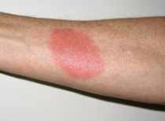
Superficial Burns
Simple erythaema
No blistering
The epidermis only
Painful

Slide 9
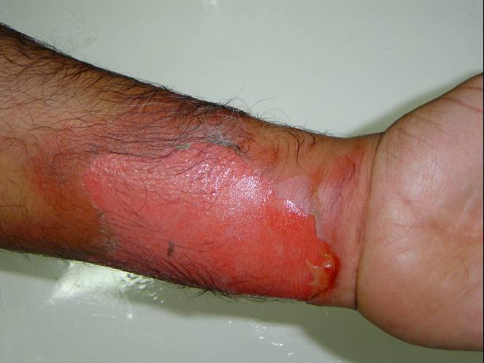
Superficial Partial Thickness Burns
Blisters – thin-walled & clear
Superficial (papillary) dermis
Very painful
Moist and red

Slide 10
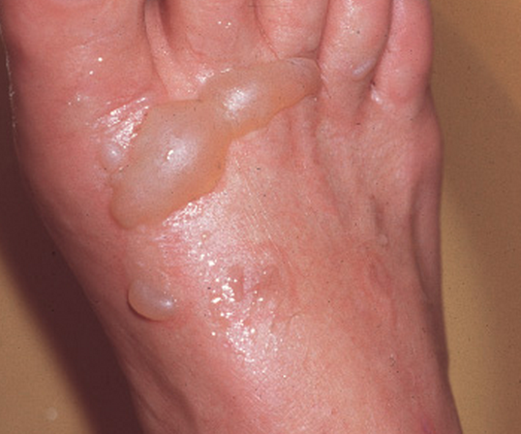
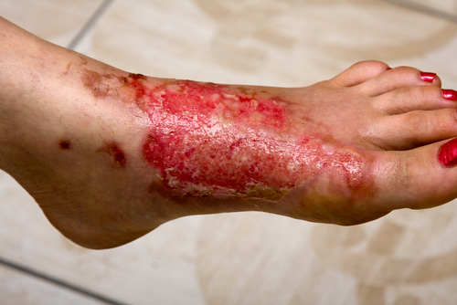
Deep Partial Thickness
Blisters – thick-walled & cloudy
Deep (reticular) dermis
Pain and tightness
Red or pale, moist usually

Slide 11
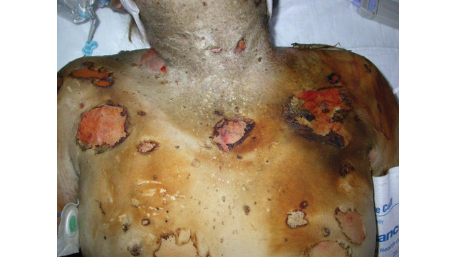
Full Thickness Burns
Brown or pale
Entire dermis
Insensate & painless
Leathery & stiff

Slide 12
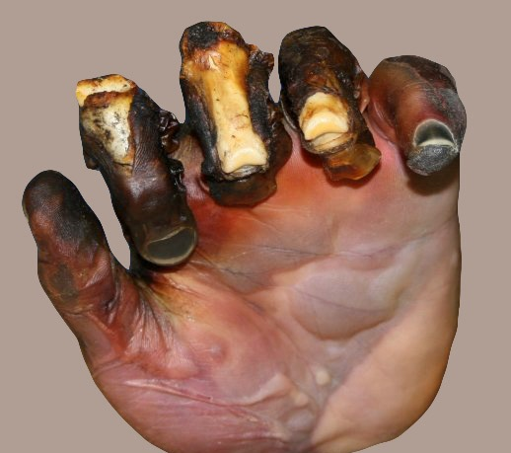
Deep Burns
Black, charred
Skin & underlying structures
Painless
Dry & dead

Slide 13
Assessment of the Area
% TBSA
Relevant to resuscitation fluid volume
Relevant to prognosis
Relevant to severity of burn

Slide 14
Minor | Moderate | Major
Adult <10% TBSA | Adult 10–20% TBSA | Adult >20% TBSA
Young or old < 5% TBSA | Young or old 5–10% TBSA | Young or old >10% TBSA
<2% full thickness burn | 2–5% full thickness burn | >5% full thickness burn
 | High voltage injury | High voltage burn
 | Possible inhalation injury | Known inhalation injury
 | Circumferential burn | Significant burn to face, joints, hands or feet
 | Other health problems | Associated injuries

Slide 15
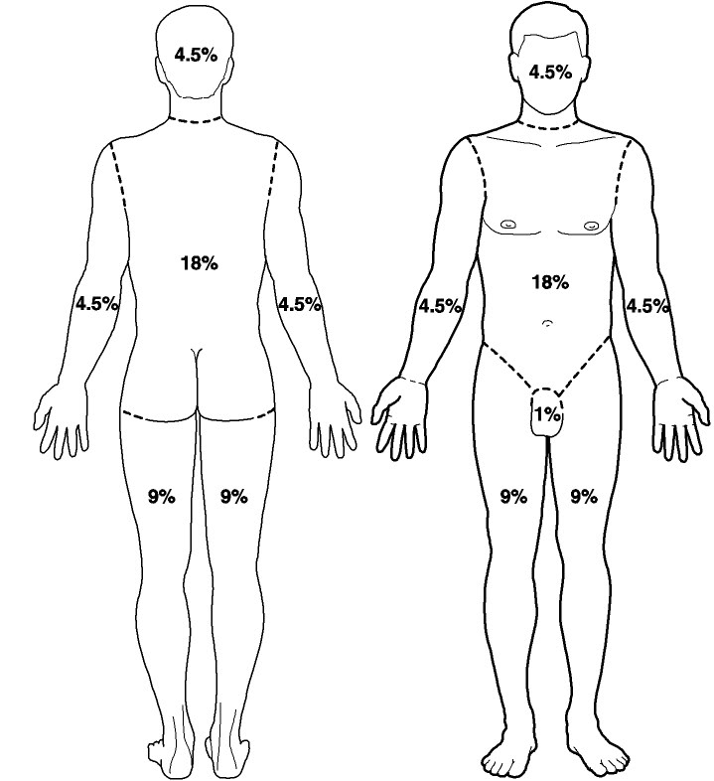
“Rule of 9s”

Slide 16
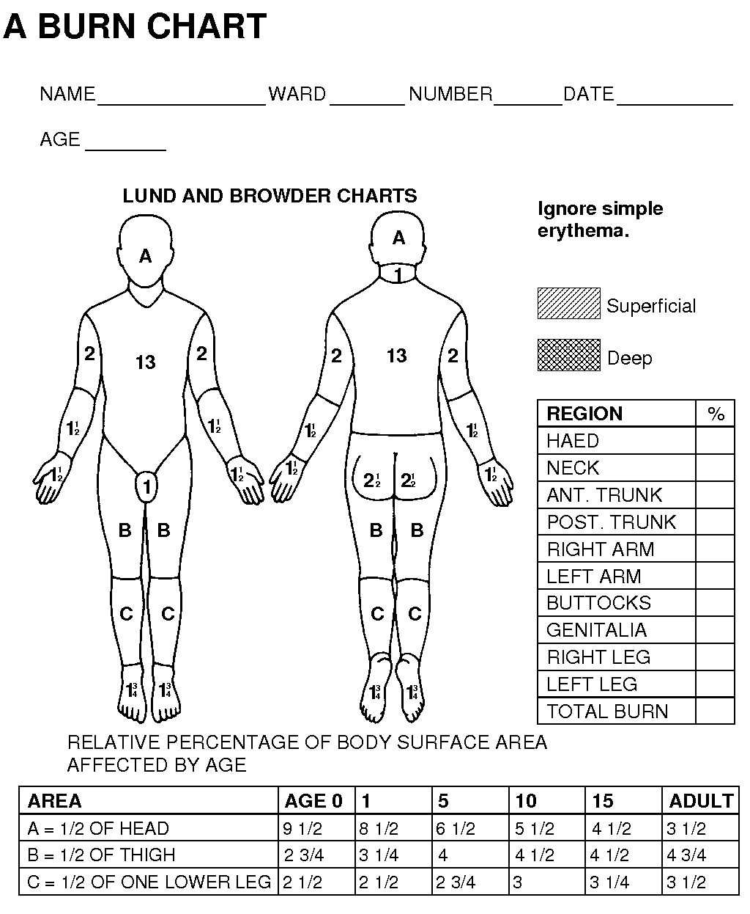
Lund and Browder
Chart

Slide 17
Resuscitation fluids – over 24hrs
Crytsalloids
Parkland Formula:
Fluid volume (in ml):
Burn area (%TBSA) x Weight (in Kg) x 4
½ in first 8 hours from time of burn
½ in next 16 hours

Slide 18
Maintenance Fluids – hourly rate:
4ml/kg for first 10kg, plus
2ml/kg for second 10kg, plus
1ml/kg thereafter
Urine output 1 – 1.5ml/kg/hr

Slide 19
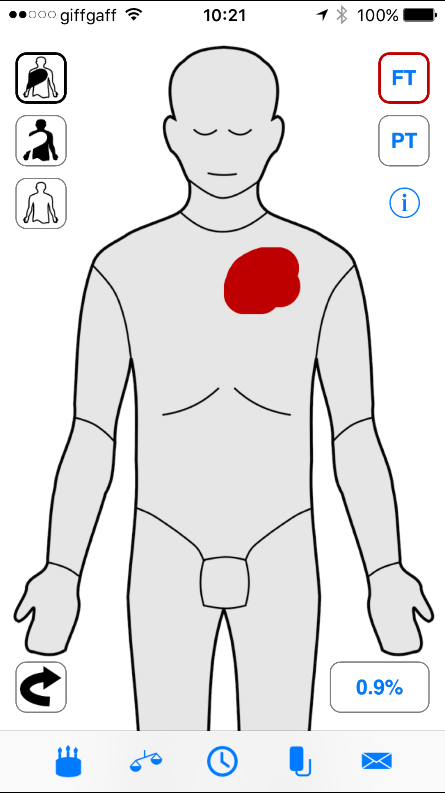
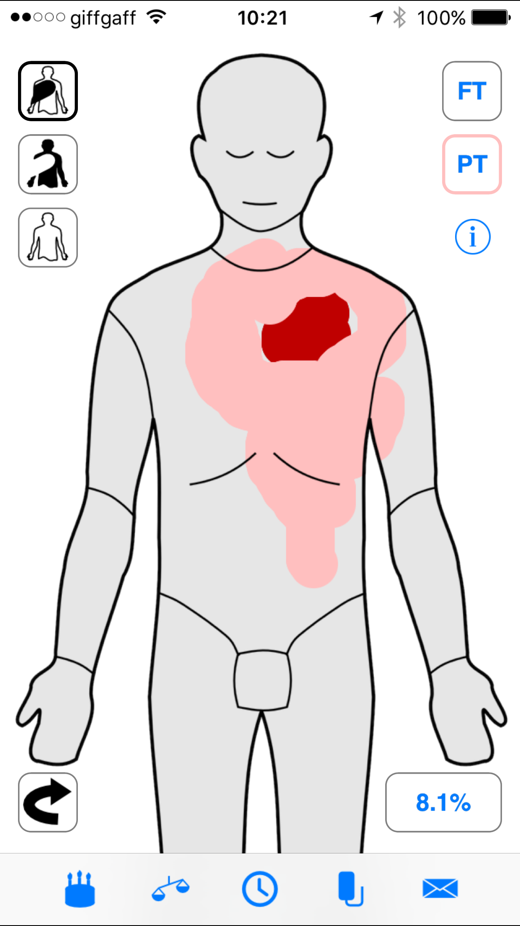
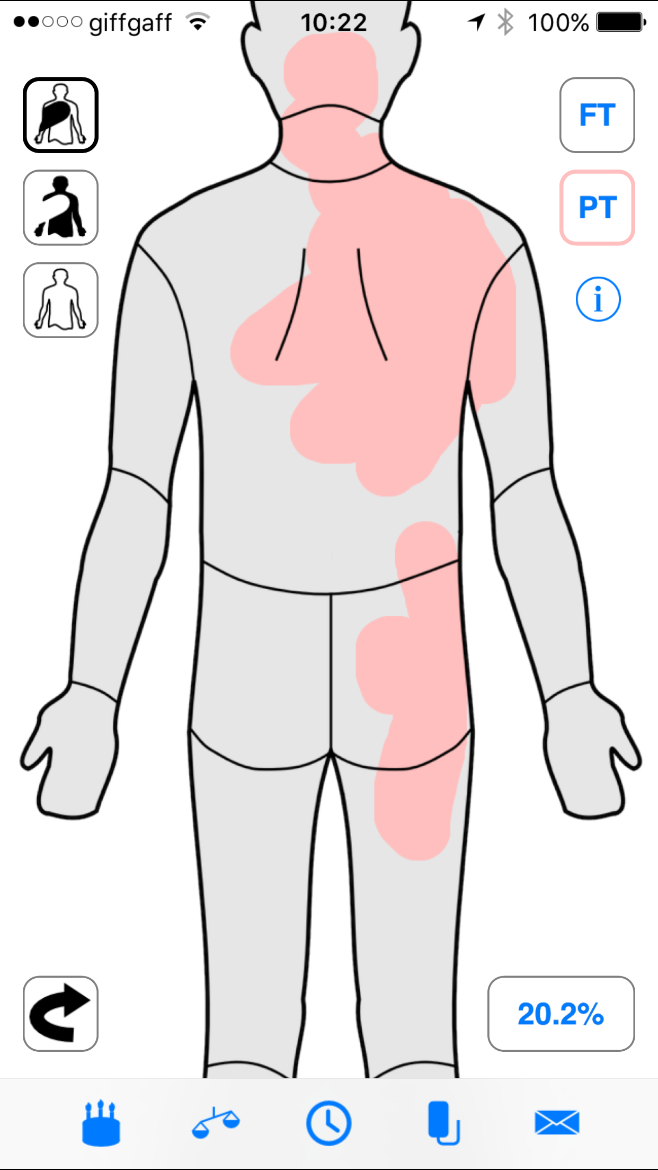
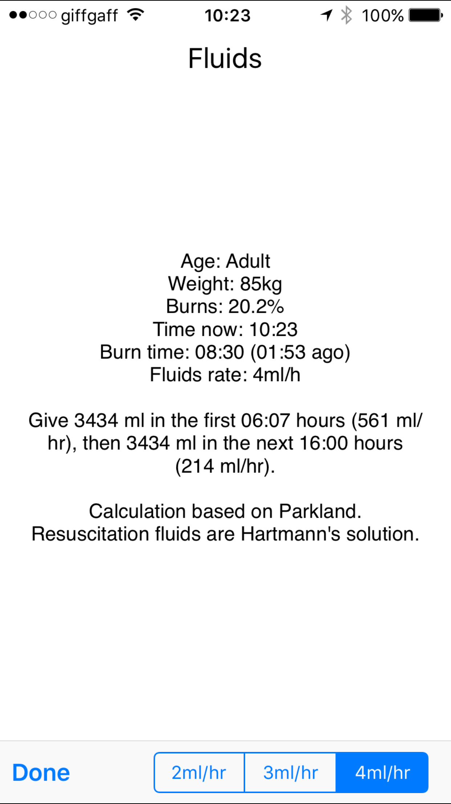

Slide 20
Special Areas
Face / Airways
Hands
Feet
Genitalia
Perineum

Slide 21
Pre-Hospital Management
Stop the burning process
Cool the burn with cold running water
Only partial thickness, less than 10% TBSA
Cover with a clean dressing
Cling film
Specialist Burn Dressings, e.g. “BurnShield”
Seek medical advice

Slide 22
Resuscitation & Initial Management
Airway
Breathing
Circulation

Slide 23
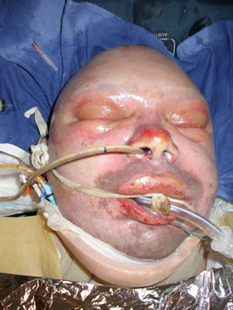
Airway
Facial burns
Airway / inhalation burns
Carbonaceous sputum
Singed nasal / facial hair
Carbon deposits on mucosa
Consider early intubation

Slide 24
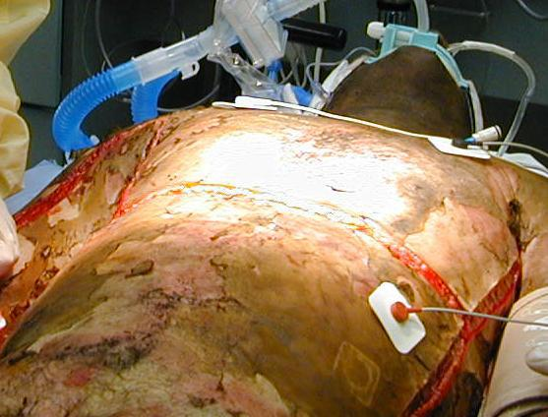
Breathing
Circumferential burns
Inhalation burns
High flow oxygen

Slide 25
Circulation
2 large-bore cannulae
Fluid resuscitation
Urinary catheter
Nasogastric tube
IV Analgesia – opiates / ketamine

Slide 26
Further management
Dressing – non-adherent material
Prevent hypothermia
Referral to Burns Centre

Slide 27
Case 1

Slide 28
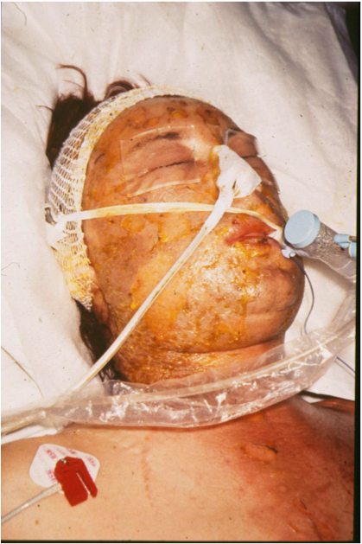
Case 2

Slide 29
?

